Slide 1


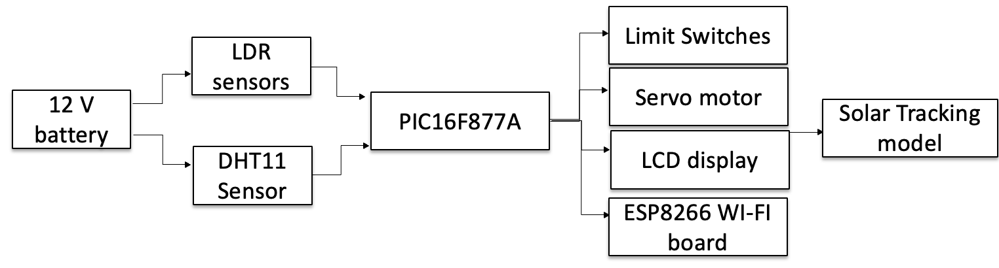
Block diagram

Slide 2
Components details
LDR sensor – detects the intensity of sunlight and helps the solar panel align with the sun for maximum energy capture.
DHT11 sensor – monitors temperature and humidity to ensure the system’s environmental safety and efficient performance.
Limit switches – prevents excessive movement of the panel by acting as mechanical stoppers, protecting motors and structure.
ESP8266 board – acts as the main controller with wi-fi support, handling sensor data, motor control, and remote monitoring.
Solar panel – converts sunlight into electrical energy, serving as the main renewable energy source of the system.
6. Thermistor: It senses temperature by changing its resistance when the temperature changes.

Slide 3
Components details cont….
Battery – Stores the generated solar power to supply energy during low sunlight or nighttime operation.
Servo Motor - It helps to rotate the solar panel accurately towards the sun.
LCD Display – Shows real-time data like voltage, temperature, and humidity for easy monitoring.
PIC16F877A – A popular 8-bit microcontroller used for controlling sensors, motors, and displays in embedded projects. It provides multiple I/O pins, ADC, timers, and serial communication, making it reliable for automation and solar tracking systems.
Buck converter: It reduces a higher voltage to a lower, stable voltage to power electronic components.

Slide 4
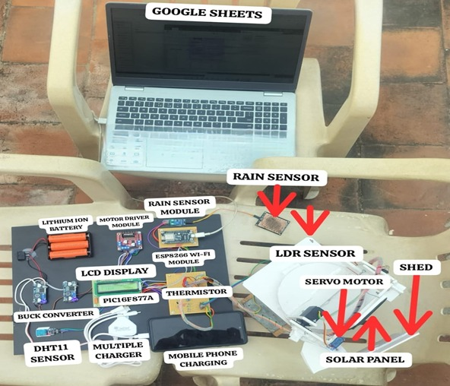
HARDWARE

Slide 5
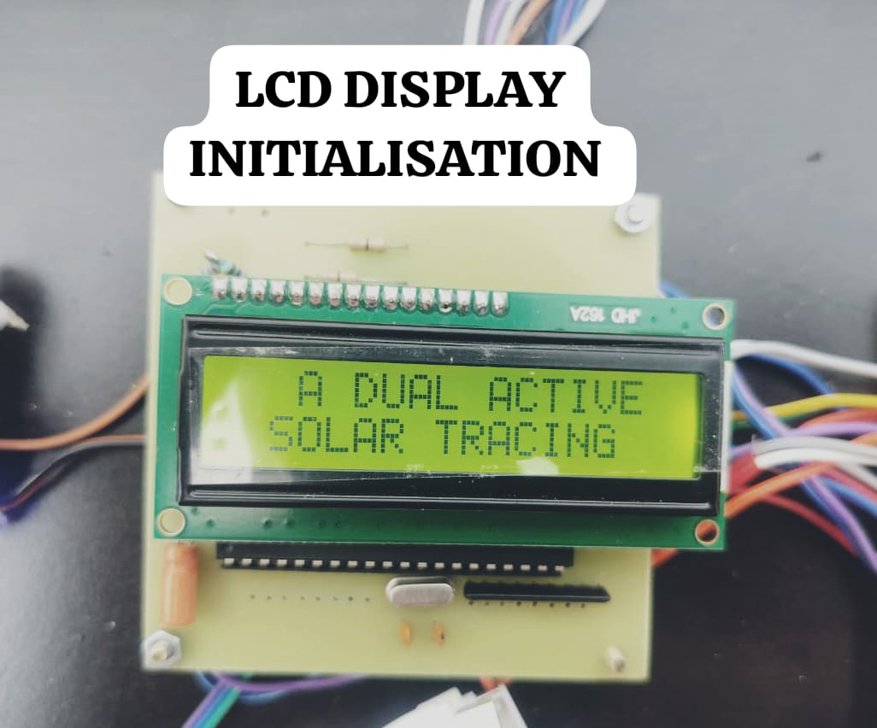
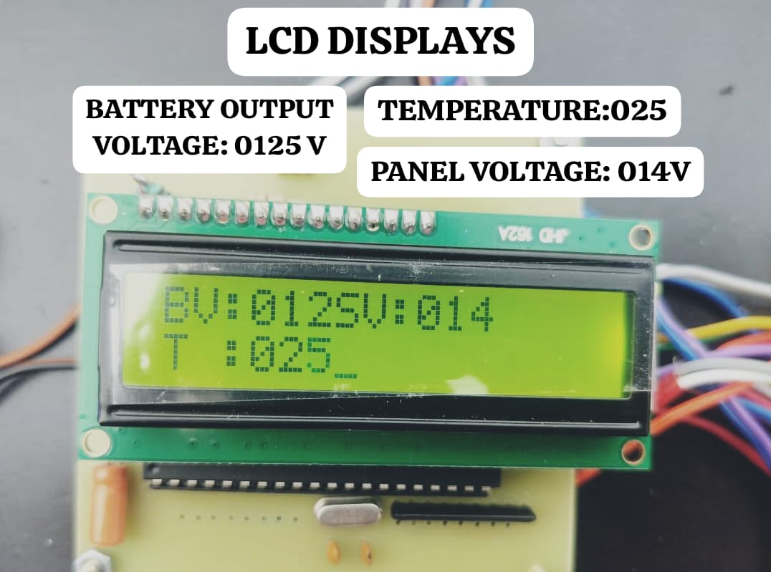
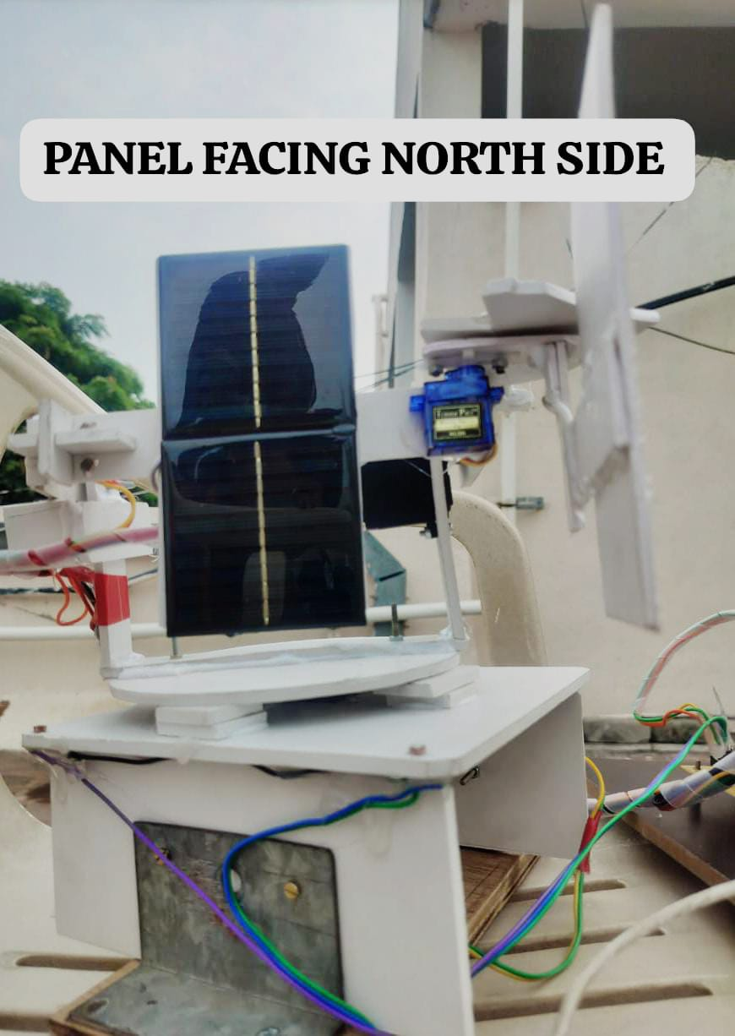
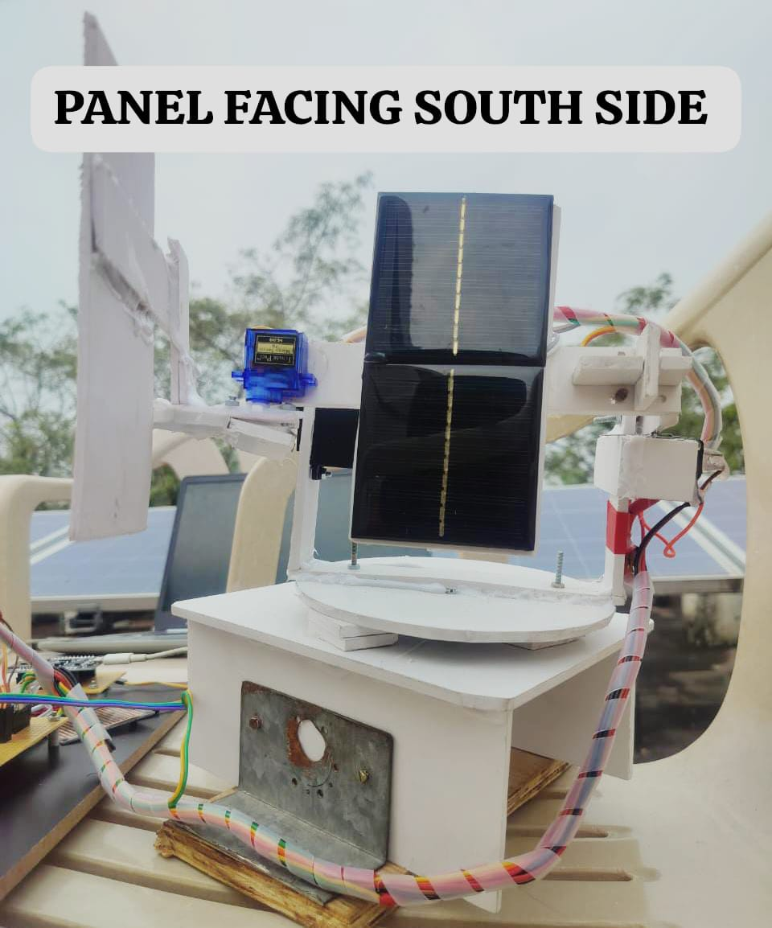
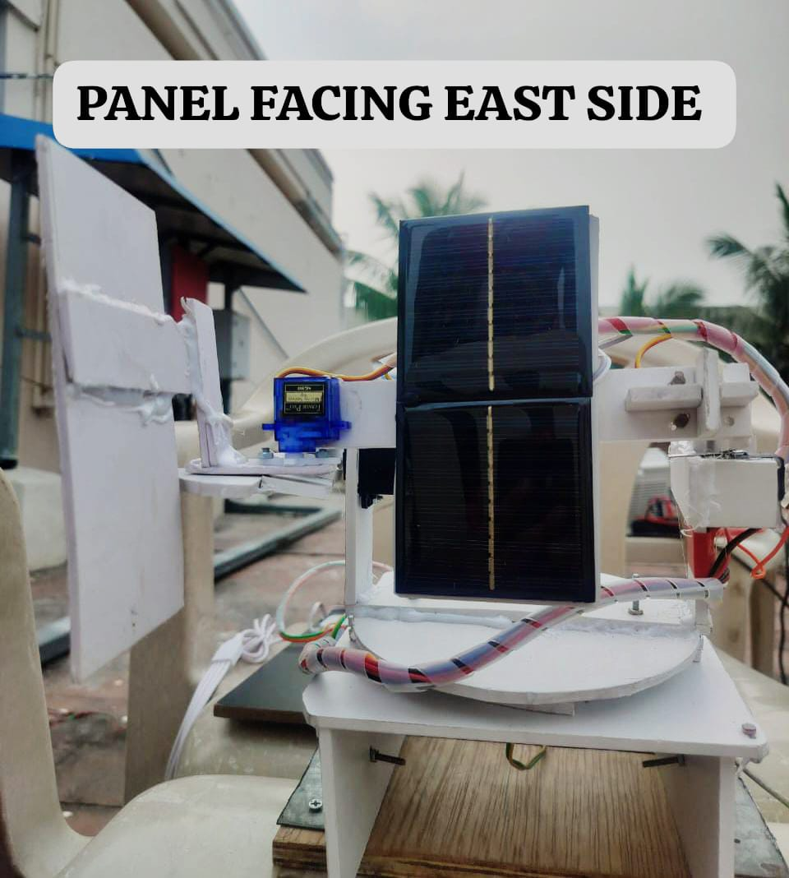
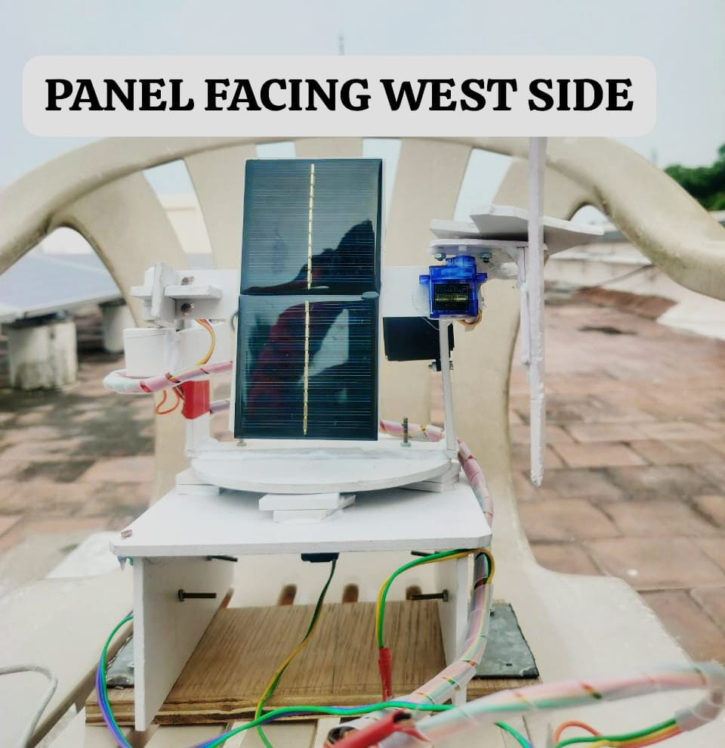
RESULT AND DISCUSSION

Slide 6
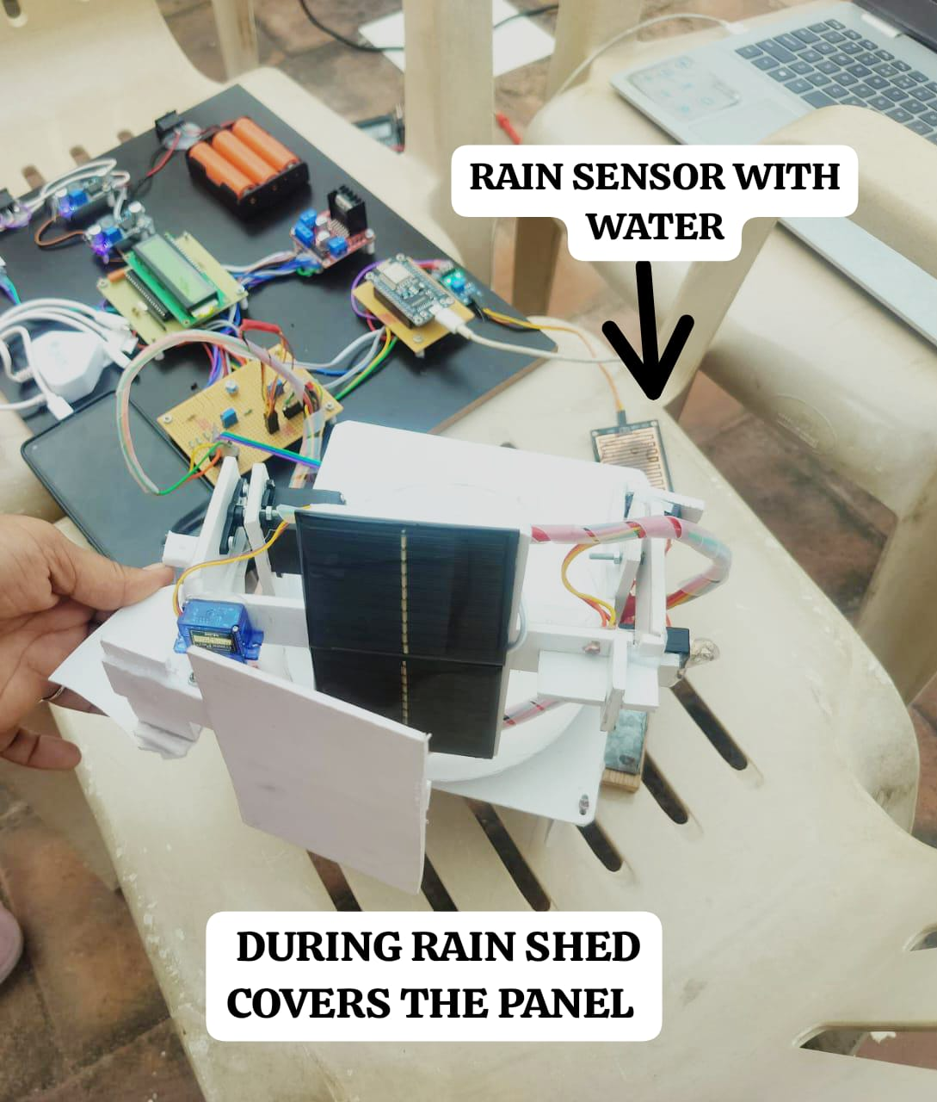
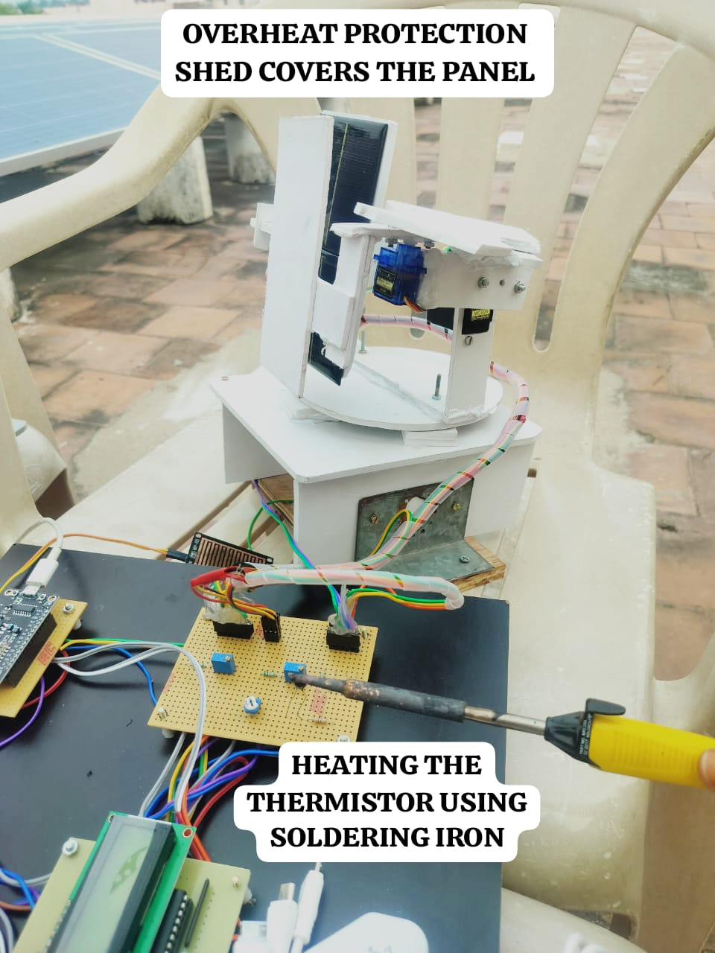
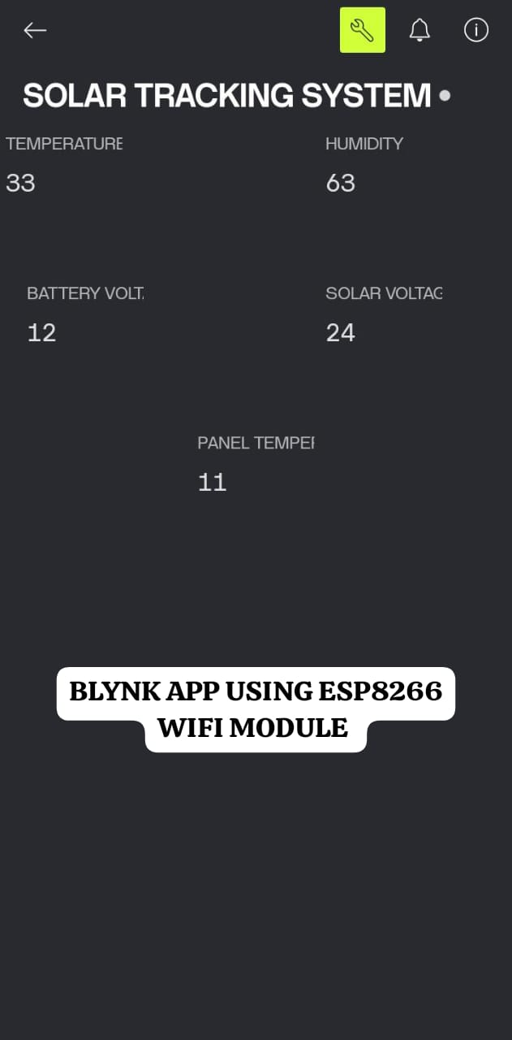
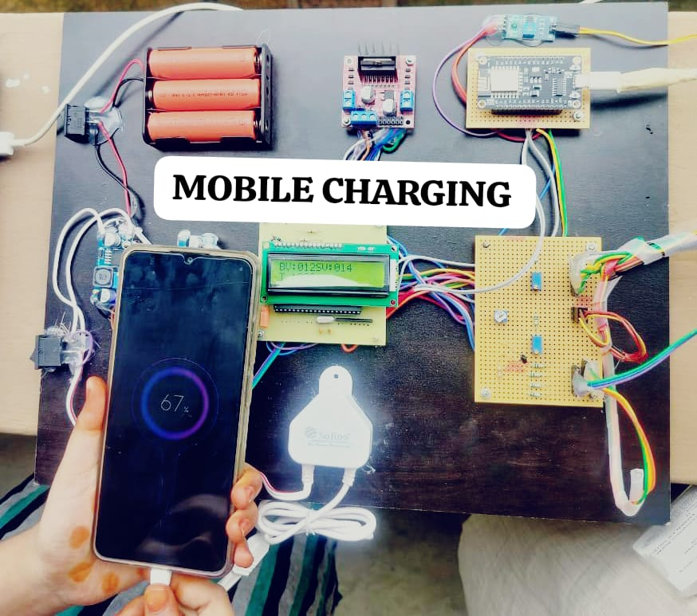
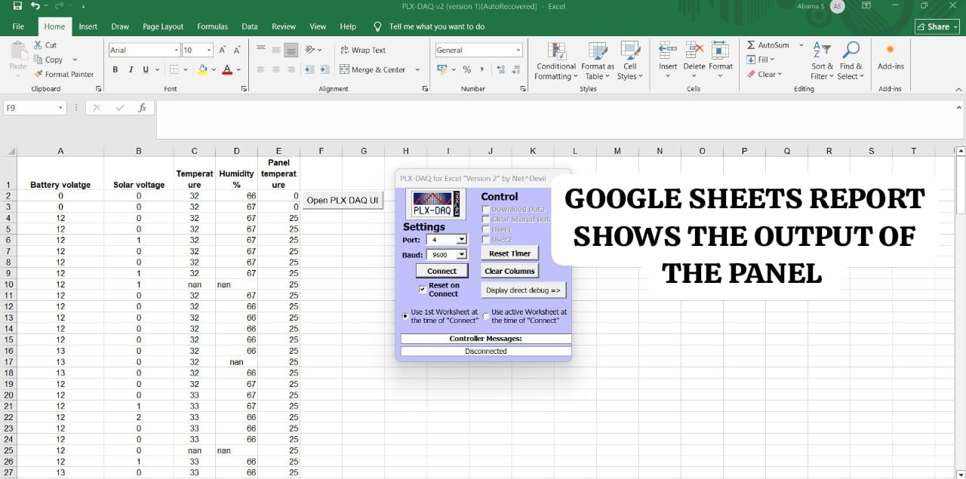
RESULT AND DISCUSSION

Slide 7
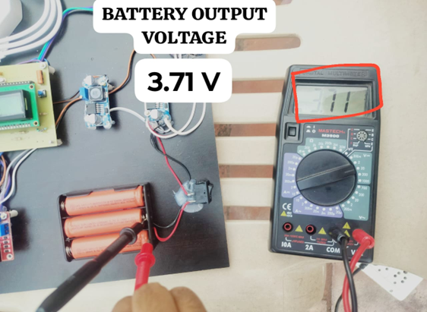
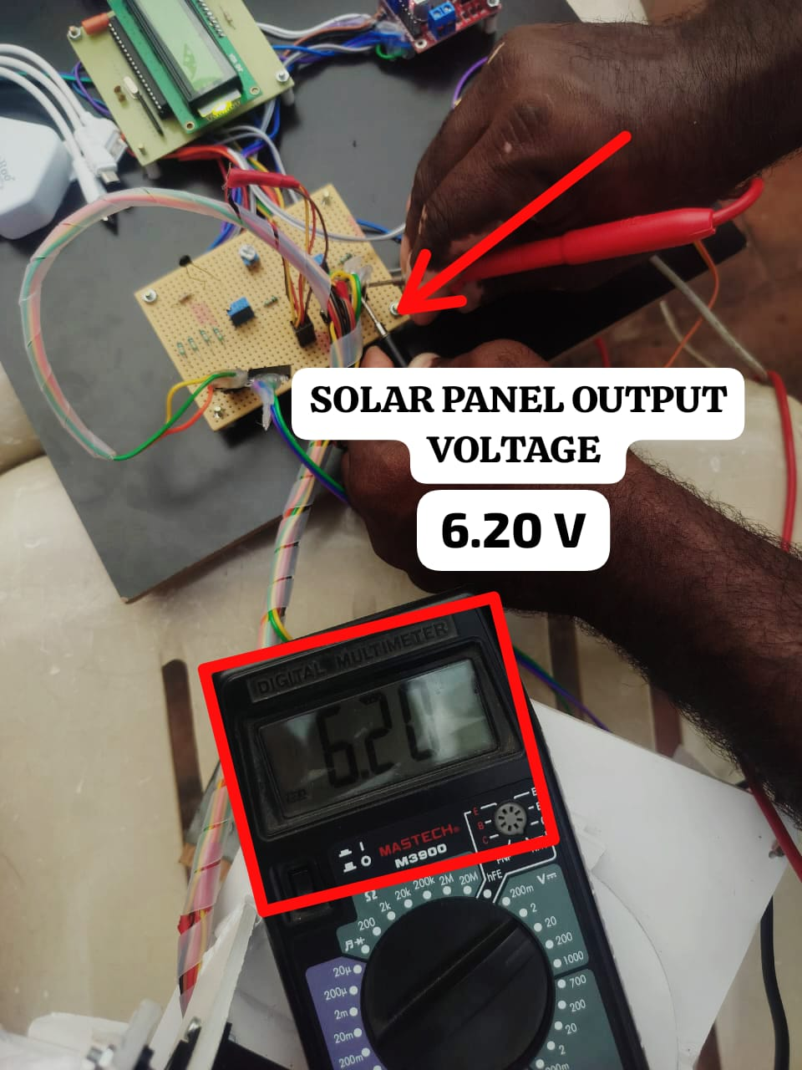
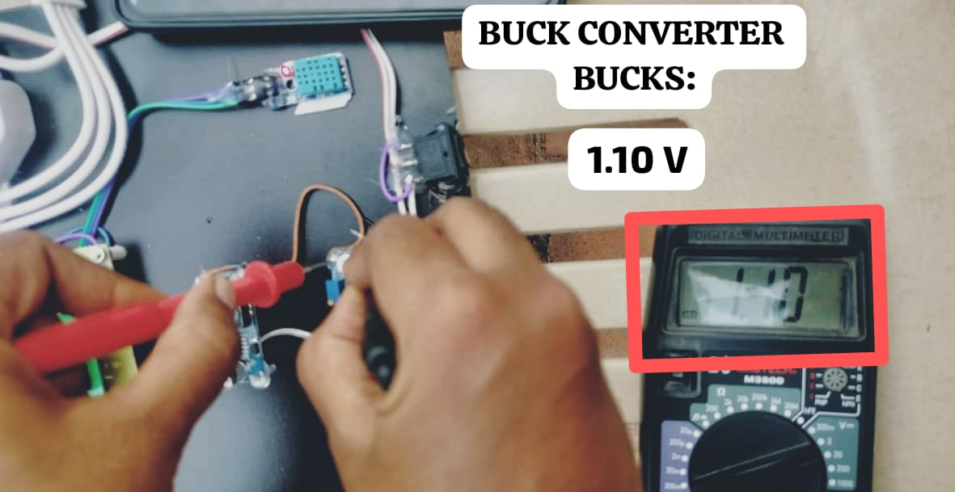
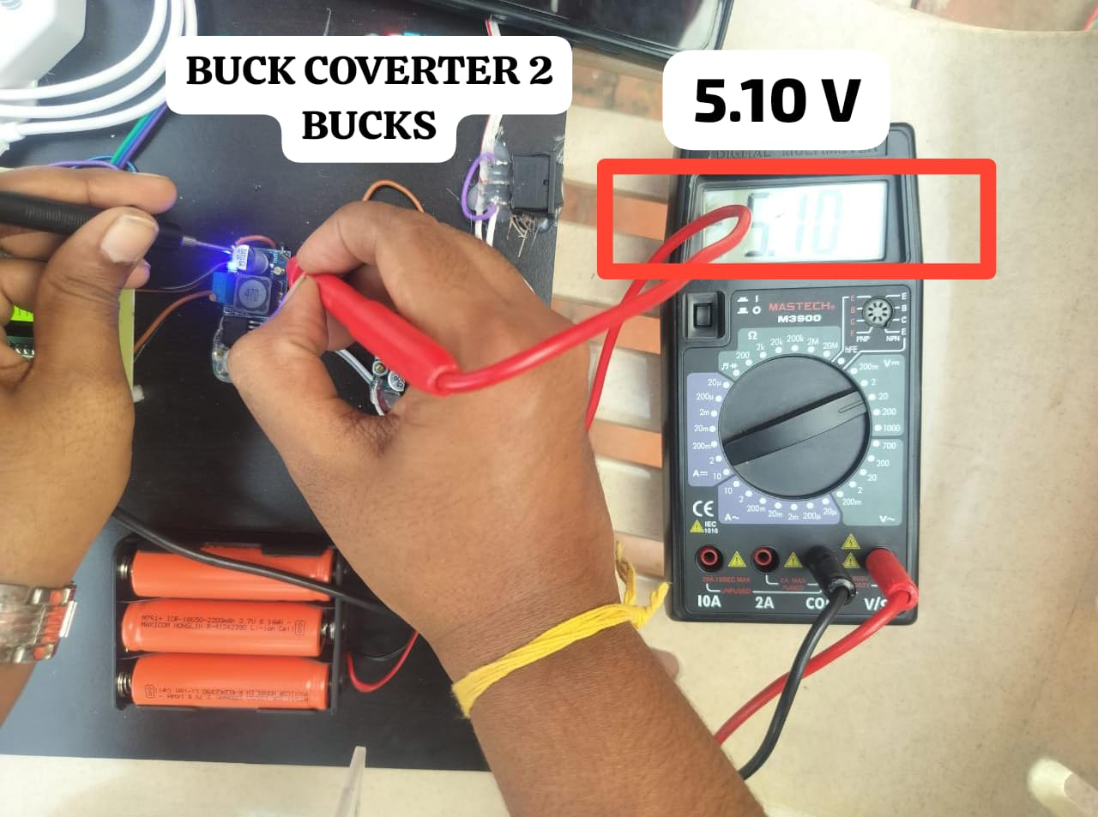
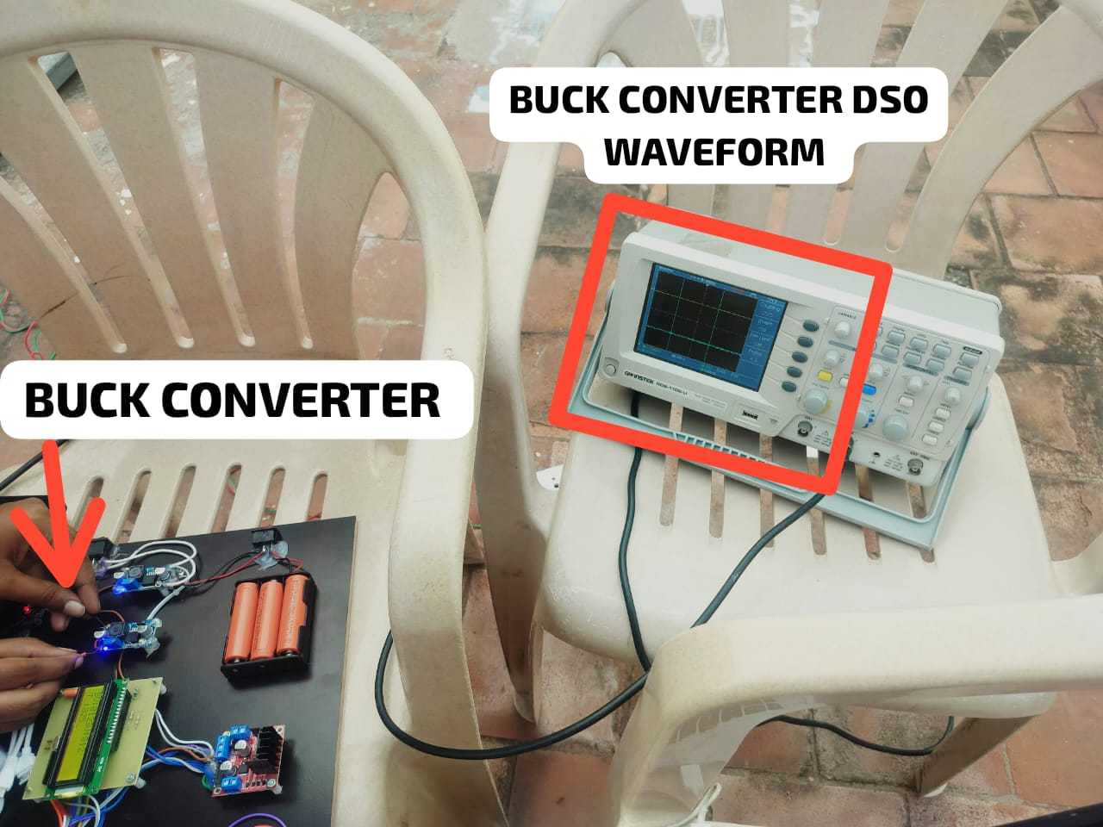
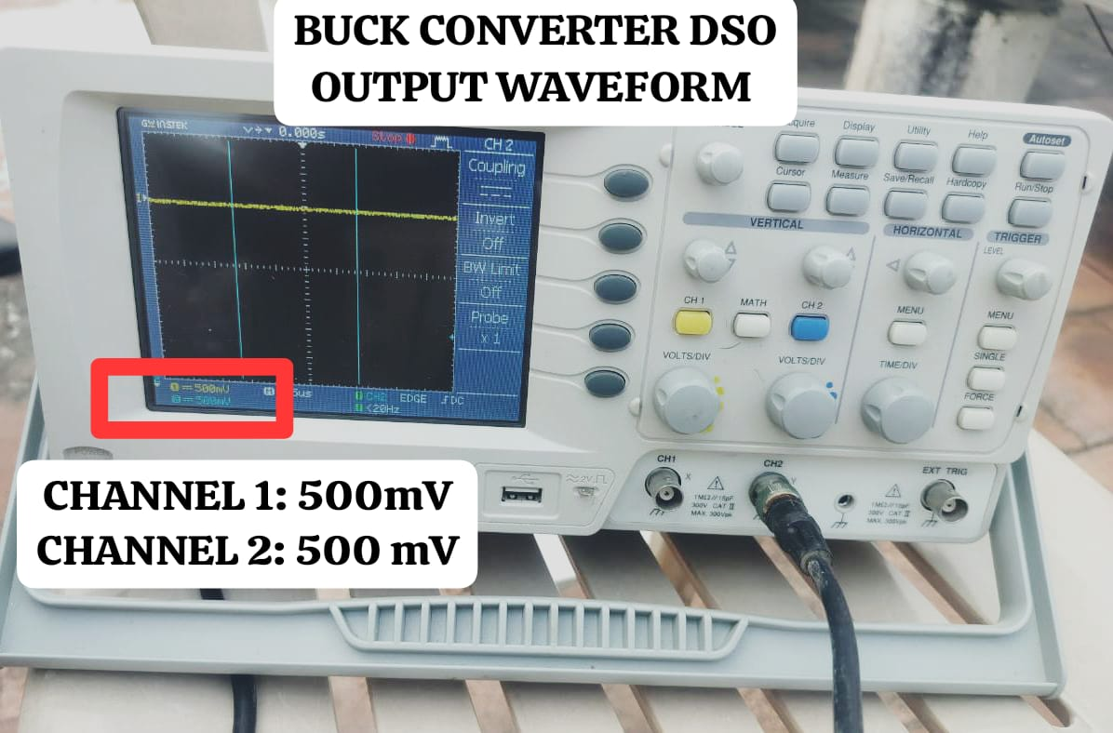
RESULT AND DISCUSSION

